Slide 1

Green Pace
Security Policy Presentation
Developer: Garrett Gibson

Slide 2

OVERVIEW: DEFENSE IN DEPTH
When developing, it is vital to consider security throughout the entire process rather than just at the end.

Slide 3
THREATS MATRIX
Likely There is a good chance it will occur. | Priority This is urgent.
Low priority This is not urgent. | Unlikely There is a good chance it will not occur.

Slide 4
10 PRINCIPLES
Validate Input Data (STD-001-CPS, STD-003-C, STD-004-CPP, STD-009-C)
Heed Compiler Warnings (STD-001-CPP, STD-008-CPP)
Architect and Design for Security Policies
Keep It Simple (STD–007-CPP, STD-010-C)
Default Deny
Adhere to the Principle of Least Privilege
Sanitize Data Sent to other Systems
Practice Defense in Depth (STD-005-C)
Use Effective Quality Assurance Techniques (STD-001-CPP)
Adopt a Secure Coding Standard (STD-006-C)

Slide 5
CODING STANDARDS
SQL Injection
Assertions
Exceptions
Data Type
Data Value
String Correctness
Memory Protection
These are the coding standards we should implement in the order listed above. This list is prioritized but it is worth mentioning that they are all important to prevent vulnerabilities.

Slide 6
ENCRYPTION POLICIES
Encryption in rest is intended for protecting data this is being stored physically. Typically in the form of encrypting the stored data and then allowing decryption when in possession of a key.
Encryption at flight deals with end to end encryption. This type of encryption can be seen in emails. Only receiving parties with the key are able to access the encrypted data.
Encryption in use is used to protect data this is actively being accessed and used. Only authorized users with proper credentials should be able to access this data.

Slide 7
TRIPLE-A POLICIES
Authentication is the handshake between a user and data that the user is trying to access. When authenticated, the identity of an account is verified as acceptable.
Authorization is user permissions to access given data. You can control whether different account types have authorization, or access, to specific data.
Accounting implies different accounts for different authorizations for data access. All account that are valid should be authenticated and granted a key credential.

Slide 8
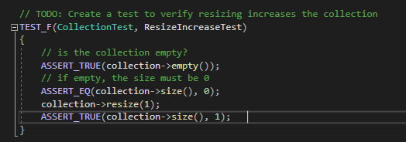
Unit Testing

Slide 9
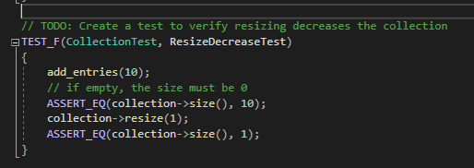
Unit Testing

Slide 10
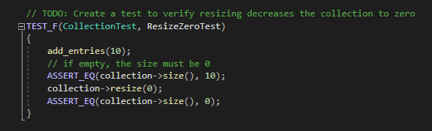
Unit Testing

Slide 11
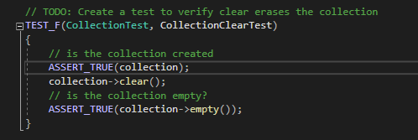
Unit Testing

Slide 12

AUTOMATION SUMMARY

Slide 13
TOOLS
The DevSecOps pipeline is all about implementing secure coding practices into the process of development rather than leaving as an afterthought once development is completed. For instance, DevSecOps has you planning for different types of threats in the pre-production phase of development. Identifying threats early leads to coding that keeps these identified threats in mind. Security becomes the forefront of development rather than a reactionary artifact to be delivered once MVP is accomplished.
Two external tools that should be a part of the DevSecOps pipeline include Dynamic Application Security Testing and Static Application Security Testing. These tools are best used when combined and should be used as part of health checks of your code base, monitoring and detecting for vulnerabilities, verify and test, and as part of your design.

Slide 14
RISKS AND BENEFITS
Following the DecSecOps pipeline and adhering to the 10 coding principles and standards outlined in our security policy will result in a better development process where secure coding practices are part of the process, not forgotten about until the end. Strategic implementation of these principles into our pipeline is something that has been absent up until this point but can no longer be ignored. Addressing vulnerabilities early and often will set us up for success and every developer and QA should take responsibility for ensuring secure coding practices are adhered to moving forward.

Slide 15
RECOMMENDATIONS
We addressed many vulnerabilities with our 10 coding standards. However, this will need to be expanded on as there are always new threat vectors and we are never done preventing new, more complex attacks.
Adopting our SQL Injection coding standard along with all of our data verification standards will help to protect against things like buffer overflow where a user can corrupt a database or gain access to areas they shouldn’t be able to. This is a common attack that will be prevented with these new coding standards.
Put together a team to continue to identify new coding standards that we should adopt as we learn and grow as an organization that takes security seriously.

Slide 16
CONCLUSIONS
Following the coding principles and standards listed in our security policy is just the beginning to secure coding. We must continue to push ourselves to learn and grow as developers in a world where so many threats exist. We are not aiming for perfection but for improvement.

